Slide 1
Problem solving using search

Slide 2
Goal Directed Agent
A goal directed agent needs to achieve certain goals.
Such an agent selects its actions based on the goal it has.
Many problems can be represented as
  a set of states and
  a set of rules of how one state is transformed to another.

Slide 3
State space
  Each state is an abstract representation of the agent's environment.
It is an abstraction that denotes a configuration of the agent.
  Initial state : The description of the starting configuration of the agent
  An action/ operator takes the agent from one state to another state. A state can have a number of successor states.
  A plan is a sequence of actions.

Slide 4
State space
  A goal is a description of a set of desirable states of the world.
  Goal states are often specified by a goal test which any goal state must satisfy.
  Path cost
    Sum of the costs at each step

Slide 5
Problem Formulation
Problem formulation means choosing a relevant set of states to consider, and a feasible set of operators for moving from one state to another.
Search is the process of considering various possible sequences of operators applied to the initial state, and finding out a sequence which culminates in a goal state.

Slide 6
Search Problem
A search problem consists of the following:
  S: the full set of states
  s0 : the initial state
  A:S→S is a set of operators
  G is the set of final states. Note that G ⊆S

Slide 7
Search Problem
The search problem is to find a sequence of actions which transforms the agent from the initial state to a goal state g∈G

Slide 8
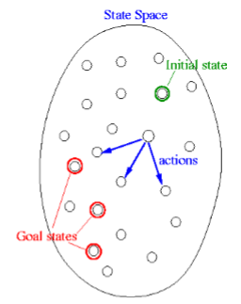
State space representation

Slide 9
Representation of search problems
A search problem is represented using a directed graph.
The states are represented as nodes.
The allowed actions are represented as arcs.

Slide 10
Plan & path
Plan: The sequence of actions is called a solution plan.
  It is a path from the initial state to a goal state.
  A plan P is a sequence of actions P = {a0, a1, … , aN} which leads to traversing a number of states {s0, s1, … , sN+1∈G}.
Path: A sequence of states is called a path.
  The cost of a path is a positive number.
  In many cases the path cost is computed by taking the sum of the costs of each action.

Slide 11
Searching process
The generic searching process can be very simply described in terms of the following steps:
Do until a solution is found or the state space is exhausted.
  Check the current state
  Execute allowable actions to find the successor states.
  Pick one of the new states.
  Check if the new state is a solution state If it is not, the new state becomes the current state and the process is repeated

Slide 12
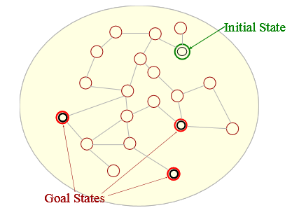
Illustration of a search process

Slide 13
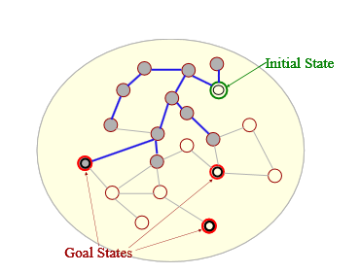
Illustration of a search process

Slide 14
Illustration of a search process
The grey nodes define the search tree.
Usually the search tree is extended one node at a time.
The order in which the search tree is extended depends on the search strategy.
We can start from a given state and follow the successors, and be able to find solution paths that lead to a goal state.

Slide 15
Example problem: Pegs and Disks problem
Consider the following problem.
  We have 3 pegs and 3 disks.
  Operators: one may move the topmost disk on any needle to the topmost position to any other needle.

Slide 16
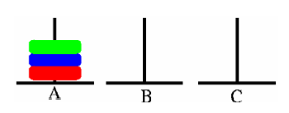
Initial state

Slide 17
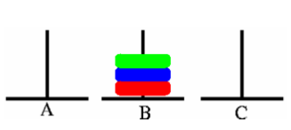
Goal state

Slide 18
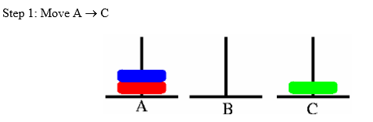
Sequence of actions

Slide 19
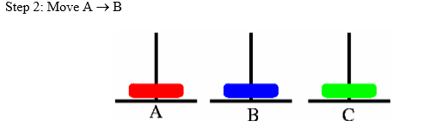
Sequence of actions

Slide 20
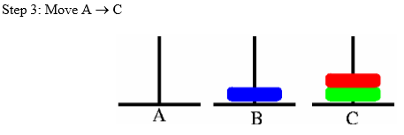
Sequence of actions

Slide 21
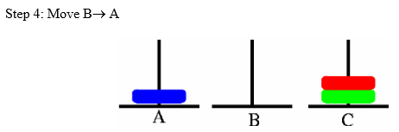
Sequence of actions

Slide 22
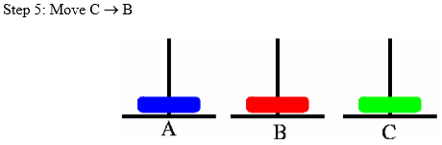
Sequence of actions

Slide 23
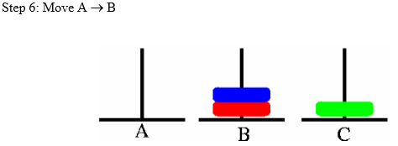
Sequence of actions

Slide 24
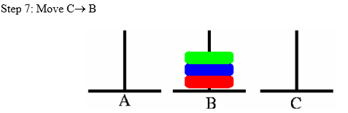
Sequence of actions

Slide 25
8 queens problem
The problem is to place 8 queens on a chessboard so that no two queens are in the same row, column or diagonal
The picture on the left shows a solution of the 8-queens problem. The picture on the right is not a correct solution, because some of the queens are attacking each other.

Slide 26
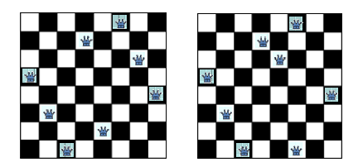
8 queens problem

Slide 27
N queens problem formulation
Problem formulation
  Deciding the representation of the states
  Selecting the initial state representation
  The description of the operators, and the successor states
We can formulate the search problem in several different ways for this problem.

Slide 28
N queens problem formulation
N queens problem formulation 1
  States: Any arrangement of 0 to 8 queens on the board
  Initial state: 0 queens on the board
  Successor function: Add a queen in any square
  Goal test: 8 queens on the board, none are attacked

Slide 29
N queens problem formulation 1
The initial state has 64 successors.
Each of the states at the next level have 63 successors, and so on.
We can restrict the search tree somewhat by considering only those successors where no queen is attacking each other. To do that we have to check the new queen against all existing queens on the board.

Slide 30
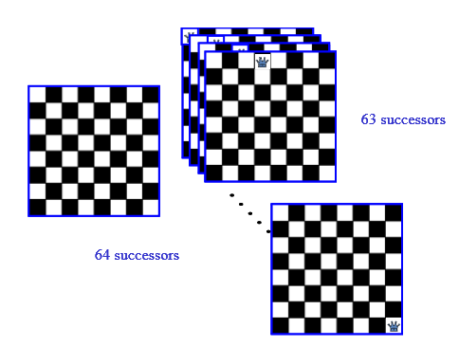
N queens problem formulation 1

Slide 31
N queens problem formulation 2
States:
  Any arrangement of 8 queens on the board
Initial state:
  All queens are at column 1
Successor function:
  Change the position of any one queen
Goal test:
  8 queens on the board, none are attacked
If we consider moving the queen at column 1, it may move to any of the seven remaining columns.

Slide 32
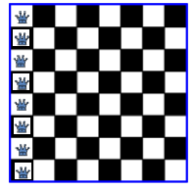
N queens problem formulation 2

Slide 33
N queens problem formulation 3
States:
  Any arrangement of k queens in the first k rows such that none are attacked
Initial state:
  0 queens on the board
Successor function:
  Add a queen to the (k+1)th row so that none are attacked.
Goal test :
  8 queens on the board, none are attacked

Slide 34
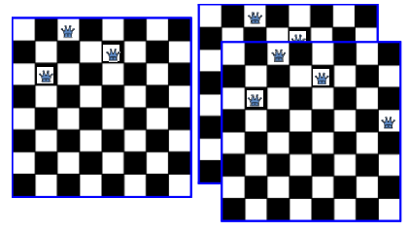
N queens problem formulation 3

Slide 35
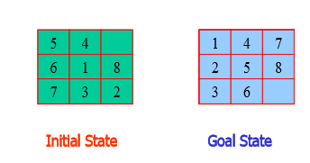
Example: 8 puzzle

Slide 36
Example: 8 puzzle
In the 8-puzzle problem we have a 3×3 square board and 8 numbered tiles.
The board has one blank position.
Bocks can be slid to adjacent blank positions.

Slide 37
Example: 8 puzzle
The state space representation for this problem is summarized below:
States:
  A state is a description of each of the eight tiles in each location that it can occupy.
Operators/Action:
  The blank moves left, right, up or down
Goal Test:
  The current state matches a certain state (e.g. one of the ones shown on previous slide)
Path Cost:
  Each move of the blank costs 1

Slide 38
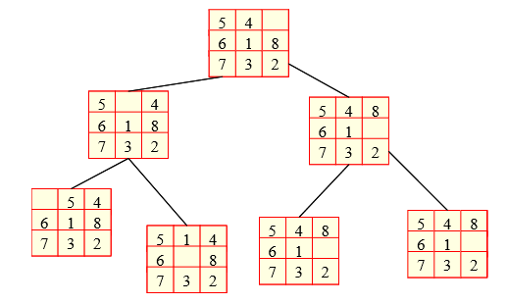
8-puzzle partial state space

Slide 39
Example: tic-tac-toe
Another example we will consider now is the game of tic-tac-toe.
This is a game that involves two players who play alternately.
Player one puts a X in an empty position. Player 2 places an O in an unoccupied position.
The player who can first get three of his symbols in the same row, column or diagonal wins.

Slide 40
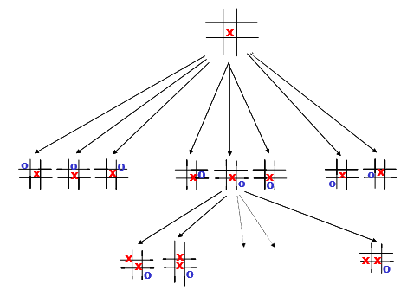
A portion of the state space of tic-tac- toe

Slide 41
Explicit vs Implicit state space
The state space may be explicitly represented by a graph.
More typically the state space can be implicitly represented and generated when required.
To generate the state space implicitly, the agent needs to know
  the initial state
  the operators and a description of the effects of the operators
An operator is a function which "expands" a node.
  Computes the successor node(s).

Slide 42
Search through a state space
Input
  Set of states
  Operators ( costs)
  Start State
  Goal State
Output
  Path: Start => a state satisfying goal test

